Slide 1


Re³: Generating Longer Stories With Recursive Reprompting and Revision
Kevin Yang, Yuandong Tian, Nanyun Peng, Dan Klein

Slide 2
Overview
Task Setup + Major Challenges
Recursive Reprompting and Revision
Results + Analysis

Slide 3
Overview
Task Setup + Major Challenges
Recursive Reprompting and Revision (Re³)

Slide 4
Overview
Task Setup + Major Challenges
Recursive Reprompting and Revision (Re³)

Slide 5
Overview
Task Setup + Major Challenges
Recursive Reprompting and Revision (Re³)

Slide 6
Input
Premise
After years of being content with only a small inheritance, Sarah's life is turned upside down when she discovers she is actually a millionaire. She must learn to navigate her new life of luxury while also dealing with the guilt she feels over her new-found fortune.

Slide 7
Re³ Story (2000+ Words)
Premise
After years of being content with only a small inheritance, Sarah's life is turned upside down when she discovers she is actually a millionaire. She must learn to navigate her new life of luxury while also dealing with the guilt she feels over her new-found fortune.
Sarah Jensen never knew she had inherited a fortune until her mother died. In fact, she had never met her father ...[15 words]...
The only thing Sarah did know was that he had died long ago and that her mother had been left a sizeable inheritance. ...[23 words]...
Sarah's mother never spent any of the money ... all that mattered to her was how much it would mean to her daughter when she inherited it ...[81 words]...
Sarah learned that she was a millionaire. ...[417 words]...
She would never have had a chance like this - an opportunity to be financially independent, to live on her own ...[544 words]...
Now that she was rich, things were going to be different for her. She could afford a hotel suite and a lavish meal if she wanted it. ...[450 words]...
The words "Forgive me, father, for I have sinned" came unbidden into her mind as she reached out for her drink and took a large sip straight from the glass. ...[383 words]...
But the guilt was weighing on her now. ...[346 words]...
Re³
Story
Re³
Story

Slide 8
Re³ Story (2000+ Words)
Premise
After years of being content with only a small inheritance, Sarah's life is turned upside down when she discovers she is actually a millionaire. She must learn to navigate her new life of luxury while also dealing with the guilt she feels over her new-found fortune.
Sarah Jensen never knew she had inherited a fortune until her mother died. In fact, she had never met her father ...[15 words]...
The only thing Sarah did know was that he had died long ago and that her mother had been left a sizeable inheritance. ...[23 words]...
Sarah's mother never spent any of the money ... all that mattered to her was how much it would mean to her daughter when she inherited it ...[81 words]...
Sarah learned that she was a millionaire. ...[417 words]...
She would never have had a chance like this - an opportunity to be financially independent, to live on her own ...[544 words]...
Now that she was rich, things were going to be different for her. She could afford a hotel suite and a lavish meal if she wanted it. ...[450 words]...
The words "Forgive me, father, for I have sinned" came unbidden into her mind as she reached out for her drink and took a large sip straight from the glass. ...[383 words]...
But the guilt was weighing on her now. ...[346 words]...
Much longer than
stories from prior work!
Re³
Story
Re³
Story

Slide 9
Major Challenges

Slide 10
Major Challenges
Long-range plot coherence
Relevance to premise
Long-range factual consistency

Slide 11
Major Challenges
Long-range plot coherence
Relevance to premise
Long-range factual consistency

Slide 12
Major Challenges
Long-range plot coherence
Relevance to premise
Long-range factual consistency

Slide 13
GPT3 Story
Premise
After years of being content with only a small inheritance, Sarah's life is turned upside down when she discovers she is actually a millionaire. She must learn to navigate her new life of luxury while also dealing with the guilt she feels over her new-found fortune.
...[19 words]...
I had no friends, no family, and no prospects for the future. ...[68 words]...
What I wouldn’t give to have been born into a life of luxury ...[502 words]...
someone must have left a bag at my place by mistake. ...[50 words]...
Inside the bag sat over a million dollars in cash! ...[62 words]...
I knew right away that it was dirty money ...[405 words]...
the first thing that I did was call the police! ...[128 words]...
“Listen lady, this isn’t your money ...[173 words]...
None of them could help me though—not my friends, not my kids, and certainly not even my husband ...[329 words]...
something told me that leaving the cash on my front step was a very deliberate and smart thing to do. ...[69 words]...
I’m going to tell you a story about someone who never existed and how they ended up on the other side of the world with a pile of cash ...[107 words]...
one of them was diagnosed with cancer. ...[58 words]...
The family used every ounce of money that they could ...[286 words]...
GPT3
Story

Slide 14
GPT3 Long-Range Coherence
Premise
After years of being content with only a small inheritance, Sarah's life is turned upside down when she discovers she is actually a millionaire. She must learn to navigate her new life of luxury while also dealing with the guilt she feels over her new-found fortune.
...[19 words]...
I had no friends, no family, and no prospects for the future. ...[68 words]...
What I wouldn’t give to have been born into a life of luxury ...[502 words]...
someone must have left a bag at my place by mistake. ...[50 words]...
Inside the bag sat over a million dollars in cash! ...[62 words]...
I knew right away that it was dirty money ...[405 words]...
the first thing that I did was call the police! ...[128 words]...
“Listen lady, this isn’t your money ...[173 words]...
None of them could help me though—not my friends, not my kids, and certainly not even my husband ...[329 words]...
something told me that leaving the cash on my front step was a very deliberate and smart thing to do. ...[69 words]...
I’m going to tell you a story about someone who never existed and how they ended up on the other side of the world with a pile of cash ...[107 words]...
one of them was diagnosed with cancer. ...[58 words]...
The family used every ounce of money that they could ...[286 words]...
GPT3
Story

Slide 15
GPT3 Long-Range Coherence
Premise
After years of being content with only a small inheritance, Sarah's life is turned upside down when she discovers she is actually a millionaire. She must learn to navigate her new life of luxury while also dealing with the guilt she feels over her new-found fortune.
...[19 words]...
I had no friends, no family, and no prospects for the future. ...[68 words]...
What I wouldn’t give to have been born into a life of luxury ...[502 words]...
someone must have left a bag at my place by mistake. ...[50 words]...
Inside the bag sat over a million dollars in cash! ...[62 words]...
I knew right away that it was dirty money ...[405 words]...
the first thing that I did was call the police! ...[128 words]...
“Listen lady, this isn’t your money ...[173 words]...
None of them could help me though—not my friends, not my kids, and certainly not even my husband ...[329 words]...
something told me that leaving the cash on my front step was a very deliberate and smart thing to do. ...[69 words]...
I’m going to tell you a story about someone who never existed and how they ended up on the other side of the world with a pile of cash ...[107 words]...
one of them was diagnosed with cancer. ...[58 words]...
The family used every ounce of money that they could ...[286 words]...
GPT3
Story

Slide 16
GPT3 Long-Range Coherence
Premise
After years of being content with only a small inheritance, Sarah's life is turned upside down when she discovers she is actually a millionaire. She must learn to navigate her new life of luxury while also dealing with the guilt she feels over her new-found fortune.
...[19 words]...
I had no friends, no family, and no prospects for the future. ...[68 words]...
What I wouldn’t give to have been born into a life of luxury ...[502 words]...
someone must have left a bag at my place by mistake. ...[50 words]...
Inside the bag sat over a million dollars in cash! ...[62 words]...
I knew right away that it was dirty money ...[405 words]...
the first thing that I did was call the police! ...[128 words]...
“Listen lady, this isn’t your money ...[173 words]...
None of them could help me though—not my friends, not my kids, and certainly not even my husband ...[329 words]...
something told me that leaving the cash on my front step was a very deliberate and smart thing to do. ...[69 words]...
I’m going to tell you a story about someone who never existed and how they ended up on the other side of the world with a pile of cash ...[107 words]...
one of them was diagnosed with cancer. ...[58 words]...
The family used every ounce of money that they could ...[286 words]...
GPT3
Story

Slide 17
GPT3 Long-Range Coherence
Premise
After years of being content with only a small inheritance, Sarah's life is turned upside down when she discovers she is actually a millionaire. She must learn to navigate her new life of luxury while also dealing with the guilt she feels over her new-found fortune.
...[19 words]...
I had no friends, no family, and no prospects for the future. ...[68 words]...
What I wouldn’t give to have been born into a life of luxury ...[502 words]...
someone must have left a bag at my place by mistake. ...[50 words]...
Inside the bag sat over a million dollars in cash! ...[62 words]...
I knew right away that it was dirty money ...[405 words]...
the first thing that I did was call the police! ...[128 words]...
“Listen lady, this isn’t your money ...[173 words]...
None of them could help me though—not my friends, not my kids, and certainly not even my husband ...[329 words]...
something told me that leaving the cash on my front step was a very deliberate and smart thing to do. ...[69 words]...
I’m going to tell you a story about someone who never existed and how they ended up on the other side of the world with a pile of cash ...[107 words]...
one of them was diagnosed with cancer. ...[58 words]...
The family used every ounce of money that they could ...[286 words]...
GPT3
Story

Slide 18
GPT3 Long-Range Coherence
Premise
After years of being content with only a small inheritance, Sarah's life is turned upside down when she discovers she is actually a millionaire. She must learn to navigate her new life of luxury while also dealing with the guilt she feels over her new-found fortune.
...[19 words]...
I had no friends, no family, and no prospects for the future. ...[68 words]...
What I wouldn’t give to have been born into a life of luxury ...[502 words]...
someone must have left a bag at my place by mistake. ...[50 words]...
Inside the bag sat over a million dollars in cash! ...[62 words]...
I knew right away that it was dirty money ...[405 words]...
the first thing that I did was call the police! ...[128 words]...
“Listen lady, this isn’t your money ...[173 words]...
None of them could help me though—not my friends, not my kids, and certainly not even my husband ...[329 words]...
something told me that leaving the cash on my front step was a very deliberate and smart thing to do. ...[69 words]...
I’m going to tell you a story about someone who never existed and how they ended up on the other side of the world with a pile of cash ...[107 words]...
one of them was diagnosed with cancer. ...[58 words]...
The family used every ounce of money that they could ...[286 words]...
GPT3
Story

Slide 19
GPT3 Long-Range Coherence
Premise
After years of being content with only a small inheritance, Sarah's life is turned upside down when she discovers she is actually a millionaire. She must learn to navigate her new life of luxury while also dealing with the guilt she feels over her new-found fortune.
...[19 words]...
I had no friends, no family, and no prospects for the future. ...[68 words]...
What I wouldn’t give to have been born into a life of luxury ...[502 words]...
someone must have left a bag at my place by mistake. ...[50 words]...
Inside the bag sat over a million dollars in cash! ...[62 words]...
I knew right away that it was dirty money ...[405 words]...
the first thing that I did was call the police! ...[128 words]...
“Listen lady, this isn’t your money ...[173 words]...
None of them could help me though—not my friends, not my kids, and certainly not even my husband ...[329 words]...
something told me that leaving the cash on my front step was a very deliberate and smart thing to do. ...[69 words]...
I’m going to tell you a story about someone who never existed and how they ended up on the other side of the world with a pile of cash ...[107 words]...
one of them was diagnosed with cancer. ...[58 words]...
The family used every ounce of money that they could ...[286 words]...
GPT3
Story

Slide 20
GPT3 Premise Relevance
Premise
After years of being content with only a small inheritance, Sarah's life is turned upside down when she discovers she is actually a millionaire. She must learn to navigate her new life of luxury while also dealing with the guilt she feels over her new-found fortune.
...[19 words]...
I had no friends, no family, and no prospects for the future. ...[68 words]...
What I wouldn’t give to have been born into a life of luxury ...[502 words]...
someone must have left a bag at my place by mistake. ...[50 words]...
Inside the bag sat over a million dollars in cash! ...[62 words]...
I knew right away that it was dirty money ...[405 words]...
the first thing that I did was call the police! ...[128 words]...
“Listen lady, this isn’t your money ...[173 words]...
None of them could help me though—not my friends, not my kids, and certainly not even my husband ...[329 words]...
something told me that leaving the cash on my front step was a very deliberate and smart thing to do. ...[69 words]...
I’m going to tell you a story about someone who never existed and how they ended up on the other side of the world with a pile of cash ...[107 words]...
one of them was diagnosed with cancer. ...[58 words]...
The family used every ounce of money that they could ...[286 words]...
GPT3
Story

Slide 21
GPT3 Premise Relevance
Premise
After years of being content with only a small inheritance, Sarah's life is turned upside down when she discovers she is actually a millionaire. She must learn to navigate her new life of luxury while also dealing with the guilt she feels over her new-found fortune.
...[19 words]...
I had no friends, no family, and no prospects for the future. ...[68 words]...
What I wouldn’t give to have been born into a life of luxury ...[502 words]...
someone must have left a bag at my place by mistake. ...[50 words]...
Inside the bag sat over a million dollars in cash! ...[62 words]...
I knew right away that it was dirty money ...[405 words]...
the first thing that I did was call the police! ...[128 words]...
“Listen lady, this isn’t your money ...[173 words]...
None of them could help me though—not my friends, not my kids, and certainly not even my husband ...[329 words]...
something told me that leaving the cash on my front step was a very deliberate and smart thing to do. ...[69 words]...
I’m going to tell you a story about someone who never existed and how they ended up on the other side of the world with a pile of cash ...[107 words]...
one of them was diagnosed with cancer. ...[58 words]...
The family used every ounce of money that they could ...[286 words]...
GPT3
Story

Slide 22
GPT3 Premise Relevance
Premise
After years of being content with only a small inheritance, Sarah's life is turned upside down when she discovers she is actually a millionaire. She must learn to navigate her new life of luxury while also dealing with the guilt she feels over her new-found fortune.
...[19 words]...
I had no friends, no family, and no prospects for the future. ...[68 words]...
What I wouldn’t give to have been born into a life of luxury ...[502 words]...
someone must have left a bag at my place by mistake. ...[50 words]...
Inside the bag sat over a million dollars in cash! ...[62 words]...
I knew right away that it was dirty money ...[405 words]...
the first thing that I did was call the police! ...[128 words]...
“Listen lady, this isn’t your money ...[173 words]...
None of them could help me though—not my friends, not my kids, and certainly not even my husband ...[329 words]...
something told me that leaving the cash on my front step was a very deliberate and smart thing to do. ...[69 words]...
I’m going to tell you a story about someone who never existed and how they ended up on the other side of the world with a pile of cash ...[107 words]...
one of them was diagnosed with cancer. ...[58 words]...
The family used every ounce of money that they could ...[286 words]...
GPT3
Story

Slide 23
GPT3 Premise Relevance
Premise
After years of being content with only a small inheritance, Sarah's life is turned upside down when she discovers she is actually a millionaire. She must learn to navigate her new life of luxury while also dealing with the guilt she feels over her new-found fortune.
...[19 words]...
I had no friends, no family, and no prospects for the future. ...[68 words]...
What I wouldn’t give to have been born into a life of luxury ...[502 words]...
someone must have left a bag at my place by mistake. ...[50 words]...
Inside the bag sat over a million dollars in cash! ...[62 words]...
I knew right away that it was dirty money ...[405 words]...
the first thing that I did was call the police! ...[128 words]...
“Listen lady, this isn’t your money ...[173 words]...
None of them could help me though—not my friends, not my kids, and certainly not even my husband ...[329 words]...
something told me that leaving the cash on my front step was a very deliberate and smart thing to do. ...[69 words]...
I’m going to tell you a story about someone who never existed and how they ended up on the other side of the world with a pile of cash ...[107 words]...
one of them was diagnosed with cancer. ...[58 words]...
The family used every ounce of money that they could ...[286 words]...
GPT3
Story

Slide 24
GPT3 Premise Relevance
Premise
After years of being content with only a small inheritance, Sarah's life is turned upside down when she discovers she is actually a millionaire. She must learn to navigate her new life of luxury while also dealing with the guilt she feels over her new-found fortune.
...[19 words]...
I had no friends, no family, and no prospects for the future. ...[68 words]...
What I wouldn’t give to have been born into a life of luxury ...[502 words]...
someone must have left a bag at my place by mistake. ...[50 words]...
Inside the bag sat over a million dollars in cash! ...[62 words]...
I knew right away that it was dirty money ...[405 words]...
the first thing that I did was call the police! ...[128 words]...
“Listen lady, this isn’t your money ...[173 words]...
None of them could help me though—not my friends, not my kids, and certainly not even my husband ...[329 words]...
something told me that leaving the cash on my front step was a very deliberate and smart thing to do. ...[69 words]...
I’m going to tell you a story about someone who never existed and how they ended up on the other side of the world with a pile of cash ...[107 words]...
one of them was diagnosed with cancer. ...[58 words]...
The family used every ounce of money that they could ...[286 words]...
GPT3
Story

Slide 25
GPT3 Premise Relevance
Premise
After years of being content with only a small inheritance, Sarah's life is turned upside down when she discovers she is actually a millionaire. She must learn to navigate her new life of luxury while also dealing with the guilt she feels over her new-found fortune.
...[19 words]...
I had no friends, no family, and no prospects for the future. ...[68 words]...
What I wouldn’t give to have been born into a life of luxury ...[502 words]...
someone must have left a bag at my place by mistake. ...[50 words]...
Inside the bag sat over a million dollars in cash! ...[62 words]...
I knew right away that it was dirty money ...[405 words]...
the first thing that I did was call the police! ...[128 words]...
“Listen lady, this isn’t your money ...[173 words]...
None of them could help me though—not my friends, not my kids, and certainly not even my husband ...[329 words]...
something told me that leaving the cash on my front step was a very deliberate and smart thing to do. ...[69 words]...
I’m going to tell you a story about someone who never existed and how they ended up on the other side of the world with a pile of cash ...[107 words]...
one of them was diagnosed with cancer. ...[58 words]...
The family used every ounce of money that they could ...[286 words]...
GPT3
Story

Slide 26
GPT3 Premise Relevance
Premise
After years of being content with only a small inheritance, Sarah's life is turned upside down when she discovers she is actually a millionaire. She must learn to navigate her new life of luxury while also dealing with the guilt she feels over her new-found fortune.
...[19 words]...
I had no friends, no family, and no prospects for the future. ...[68 words]...
What I wouldn’t give to have been born into a life of luxury ...[502 words]...
someone must have left a bag at my place by mistake. ...[50 words]...
Inside the bag sat over a million dollars in cash! ...[62 words]...
I knew right away that it was dirty money ...[405 words]...
the first thing that I did was call the police! ...[128 words]...
“Listen lady, this isn’t your money ...[173 words]...
None of them could help me though—not my friends, not my kids, and certainly not even my husband ...[329 words]...
something told me that leaving the cash on my front step was a very deliberate and smart thing to do. ...[69 words]...
I’m going to tell you a story about someone who never existed and how they ended up on the other side of the world with a pile of cash ...[107 words]...
one of them was diagnosed with cancer. ...[58 words]...
The family used every ounce of money that they could ...[286 words]...
GPT3
Story

Slide 27
GPT3 Premise Relevance
Premise
After years of being content with only a small inheritance, Sarah's life is turned upside down when she discovers she is actually a millionaire. She must learn to navigate her new life of luxury while also dealing with the guilt she feels over her new-found fortune.
...[19 words]...
I had no friends, no family, and no prospects for the future. ...[68 words]...
What I wouldn’t give to have been born into a life of luxury ...[502 words]...
someone must have left a bag at my place by mistake. ...[50 words]...
Inside the bag sat over a million dollars in cash! ...[62 words]...
I knew right away that it was dirty money ...[405 words]...
the first thing that I did was call the police! ...[128 words]...
“Listen lady, this isn’t your money ...[173 words]...
None of them could help me though—not my friends, not my kids, and certainly not even my husband ...[329 words]...
something told me that leaving the cash on my front step was a very deliberate and smart thing to do. ...[69 words]...
I’m going to tell you a story about someone who never existed and how they ended up on the other side of the world with a pile of cash ...[107 words]...
one of them was diagnosed with cancer. ...[58 words]...
The family used every ounce of money that they could ...[286 words]...
GPT3
Story

Slide 28
GPT3 Premise Relevance
Premise
After years of being content with only a small inheritance, Sarah's life is turned upside down when she discovers she is actually a millionaire. She must learn to navigate her new life of luxury while also dealing with the guilt she feels over her new-found fortune.
...[19 words]...
I had no friends, no family, and no prospects for the future. ...[68 words]...
What I wouldn’t give to have been born into a life of luxury ...[502 words]...
someone must have left a bag at my place by mistake. ...[50 words]...
Inside the bag sat over a million dollars in cash! ...[62 words]...
I knew right away that it was dirty money ...[405 words]...
the first thing that I did was call the police! ...[128 words]...
“Listen lady, this isn’t your money ...[173 words]...
None of them could help me though—not my friends, not my kids, and certainly not even my husband ...[329 words]...
something told me that leaving the cash on my front step was a very deliberate and smart thing to do. ...[69 words]...
I’m going to tell you a story about someone who never existed and how they ended up on the other side of the world with a pile of cash ...[107 words]...
one of them was diagnosed with cancer. ...[58 words]...
The family used every ounce of money that they could ...[286 words]...
GPT3
Story

Slide 29
GPT3 Factual Consistency
Premise
After years of being content with only a small inheritance, Sarah's life is turned upside down when she discovers she is actually a millionaire. She must learn to navigate her new life of luxury while also dealing with the guilt she feels over her new-found fortune.
...[19 words]...
I had no friends, no family, and no prospects for the future. ...[68 words]...
What I wouldn’t give to have been born into a life of luxury ...[502 words]...
someone must have left a bag at my place by mistake. ...[50 words]...
Inside the bag sat over a million dollars in cash! ...[62 words]...
I knew right away that it was dirty money ...[405 words]...
the first thing that I did was call the police! ...[128 words]...
“Listen lady, this isn’t your money ...[173 words]...
None of them could help me though—not my friends, not my kids, and certainly not even my husband ...[329 words]...
something told me that leaving the cash on my front step was a very deliberate and smart thing to do. ...[69 words]...
I’m going to tell you a story about someone who never existed and how they ended up on the other side of the world with a pile of cash ...[107 words]...
one of them was diagnosed with cancer. ...[58 words]...
The family used every ounce of money that they could ...[286 words]...
GPT3
Story

Slide 30
GPT3 Factual Consistency
Premise
After years of being content with only a small inheritance, Sarah's life is turned upside down when she discovers she is actually a millionaire. She must learn to navigate her new life of luxury while also dealing with the guilt she feels over her new-found fortune.
...[19 words]...
I had no friends, no family, and no prospects for the future. ...[68 words]...
What I wouldn’t give to have been born into a life of luxury ...[502 words]...
someone must have left a bag at my place by mistake. ...[50 words]...
Inside the bag sat over a million dollars in cash! ...[62 words]...
I knew right away that it was dirty money ...[405 words]...
the first thing that I did was call the police! ...[128 words]...
“Listen lady, this isn’t your money ...[173 words]...
None of them could help me though—not my friends, not my kids, and certainly not even my husband ...[329 words]...
something told me that leaving the cash on my front step was a very deliberate and smart thing to do. ...[69 words]...
I’m going to tell you a story about someone who never existed and how they ended up on the other side of the world with a pile of cash ...[107 words]...
one of them was diagnosed with cancer. ...[58 words]...
The family used every ounce of money that they could ...[286 words]...
GPT3
Story

Slide 31
GPT3 Factual Consistency
Premise
After years of being content with only a small inheritance, Sarah's life is turned upside down when she discovers she is actually a millionaire. She must learn to navigate her new life of luxury while also dealing with the guilt she feels over her new-found fortune.
...[19 words]...
I had no friends, no family, and no prospects for the future. ...[68 words]...
What I wouldn’t give to have been born into a life of luxury ...[502 words]...
someone must have left a bag at my place by mistake. ...[50 words]...
Inside the bag sat over a million dollars in cash! ...[62 words]...
I knew right away that it was dirty money ...[405 words]...
the first thing that I did was call the police! ...[128 words]...
“Listen lady, this isn’t your money ...[173 words]...
None of them could help me though—not my friends, not my kids, and certainly not even my husband ...[329 words]...
something told me that leaving the cash on my front step was a very deliberate and smart thing to do. ...[69 words]...
I’m going to tell you a story about someone who never existed and how they ended up on the other side of the world with a pile of cash ...[107 words]...
one of them was diagnosed with cancer. ...[58 words]...
The family used every ounce of money that they could ...[286 words]...
GPT3
Story

Slide 32
Re³ Story
Premise
After years of being content with only a small inheritance, Sarah's life is turned upside down when she discovers she is actually a millionaire. She must learn to navigate her new life of luxury while also dealing with the guilt she feels over her new-found fortune.
Sarah Jensen never knew she had inherited a fortune until her mother died. In fact, she had never met her father ...[15 words]...
The only thing Sarah did know was that he had died long ago and that her mother had been left a sizeable inheritance. ...[23 words]...
Sarah's mother never spent any of the money ... all that mattered to her was how much it would mean to her daughter when she inherited it ...[81 words]...
Sarah learned that she was a millionaire. ...[417 words]...
She would never have had a chance like this - an opportunity to be financially independent, to live on her own ...[544 words]...
Now that she was rich, things were going to be different for her. She could afford a hotel suite and a lavish meal if she wanted it. ...[450 words]...
The words "Forgive me, father, for I have sinned" came unbidden into her mind as she reached out for her drink and took a large sip straight from the glass. ...[383 words]...
But the guilt was weighing on her now. ...[346 words]...
Re³
Story
Re³
Story

Slide 33
Re³ Long-Range Coherence
Premise
After years of being content with only a small inheritance, Sarah's life is turned upside down when she discovers she is actually a millionaire. She must learn to navigate her new life of luxury while also dealing with the guilt she feels over her new-found fortune.
Sarah Jensen never knew she had inherited a fortune until her mother died. In fact, she had never met her father ...[15 words]...
The only thing Sarah did know was that he had died long ago and that her mother had been left a sizeable inheritance. ...[23 words]...
Sarah's mother never spent any of the money ... all that mattered to her was how much it would mean to her daughter when she inherited it ...[81 words]...
Sarah learned that she was a millionaire. ...[417 words]...
She would never have had a chance like this - an opportunity to be financially independent, to live on her own ...[544 words]...
Now that she was rich, things were going to be different for her. She could afford a hotel suite and a lavish meal if she wanted it. ...[450 words]...
The words "Forgive me, father, for I have sinned" came unbidden into her mind as she reached out for her drink and took a large sip straight from the glass. ...[383 words]...
But the guilt was weighing on her now. ...[346 words]...
Re³
Story
Re³
Story

Slide 34
Re³ Long-Range Coherence
Premise
After years of being content with only a small inheritance, Sarah's life is turned upside down when she discovers she is actually a millionaire. She must learn to navigate her new life of luxury while also dealing with the guilt she feels over her new-found fortune.
Sarah Jensen never knew she had inherited a fortune until her mother died. In fact, she had never met her father ...[15 words]...
The only thing Sarah did know was that he had died long ago and that her mother had been left a sizeable inheritance. ...[23 words]...
Sarah's mother never spent any of the money ... all that mattered to her was how much it would mean to her daughter when she inherited it ...[81 words]...
Sarah learned that she was a millionaire. ...[417 words]...
She would never have had a chance like this - an opportunity to be financially independent, to live on her own ...[544 words]...
Now that she was rich, things were going to be different for her. She could afford a hotel suite and a lavish meal if she wanted it. ...[450 words]...
The words "Forgive me, father, for I have sinned" came unbidden into her mind as she reached out for her drink and took a large sip straight from the glass. ...[383 words]...
But the guilt was weighing on her now. ...[346 words]...
Re³
Story
Re³
Story

Slide 35
Re³ Long-Range Coherence
Premise
After years of being content with only a small inheritance, Sarah's life is turned upside down when she discovers she is actually a millionaire. She must learn to navigate her new life of luxury while also dealing with the guilt she feels over her new-found fortune.
Sarah Jensen never knew she had inherited a fortune until her mother died. In fact, she had never met her father ...[15 words]...
The only thing Sarah did know was that he had died long ago and that her mother had been left a sizeable inheritance. ...[23 words]...
Sarah's mother never spent any of the money ... all that mattered to her was how much it would mean to her daughter when she inherited it ...[81 words]...
Sarah learned that she was a millionaire. ...[417 words]...
She would never have had a chance like this - an opportunity to be financially independent, to live on her own ...[544 words]...
Now that she was rich, things were going to be different for her. She could afford a hotel suite and a lavish meal if she wanted it. ...[450 words]...
The words "Forgive me, father, for I have sinned" came unbidden into her mind as she reached out for her drink and took a large sip straight from the glass. ...[383 words]...
But the guilt was weighing on her now. ...[346 words]...
Re³
Story
Re³
Story

Slide 36
Re³ Long-Range Coherence
Premise
After years of being content with only a small inheritance, Sarah's life is turned upside down when she discovers she is actually a millionaire. She must learn to navigate her new life of luxury while also dealing with the guilt she feels over her new-found fortune.
Sarah Jensen never knew she had inherited a fortune until her mother died. In fact, she had never met her father ...[15 words]...
The only thing Sarah did know was that he had died long ago and that her mother had been left a sizeable inheritance. ...[23 words]...
Sarah's mother never spent any of the money ... all that mattered to her was how much it would mean to her daughter when she inherited it ...[81 words]...
Sarah learned that she was a millionaire. ...[417 words]...
She would never have had a chance like this - an opportunity to be financially independent, to live on her own ...[544 words]...
Now that she was rich, things were going to be different for her. She could afford a hotel suite and a lavish meal if she wanted it. ...[450 words]...
The words "Forgive me, father, for I have sinned" came unbidden into her mind as she reached out for her drink and took a large sip straight from the glass. ...[383 words]...
But the guilt was weighing on her now. ...[346 words]...
Re³
Story
Re³
Story

Slide 37
Re³ Long-Range Coherence
Premise
After years of being content with only a small inheritance, Sarah's life is turned upside down when she discovers she is actually a millionaire. She must learn to navigate her new life of luxury while also dealing with the guilt she feels over her new-found fortune.
Sarah Jensen never knew she had inherited a fortune until her mother died. In fact, she had never met her father ...[15 words]...
The only thing Sarah did know was that he had died long ago and that her mother had been left a sizeable inheritance. ...[23 words]...
Sarah's mother never spent any of the money ... all that mattered to her was how much it would mean to her daughter when she inherited it ...[81 words]...
Sarah learned that she was a millionaire. ...[417 words]...
She would never have had a chance like this - an opportunity to be financially independent, to live on her own ...[544 words]...
Now that she was rich, things were going to be different for her. She could afford a hotel suite and a lavish meal if she wanted it. ...[450 words]...
The words "Forgive me, father, for I have sinned" came unbidden into her mind as she reached out for her drink and took a large sip straight from the glass. ...[383 words]...
But the guilt was weighing on her now. ...[346 words]...
Re³
Story
Re³
Story

Slide 38
Re³ Long-Range Coherence
Premise
After years of being content with only a small inheritance, Sarah's life is turned upside down when she discovers she is actually a millionaire. She must learn to navigate her new life of luxury while also dealing with the guilt she feels over her new-found fortune.
Sarah Jensen never knew she had inherited a fortune until her mother died. In fact, she had never met her father ...[15 words]...
The only thing Sarah did know was that he had died long ago and that her mother had been left a sizeable inheritance. ...[23 words]...
Sarah's mother never spent any of the money ... all that mattered to her was how much it would mean to her daughter when she inherited it ...[81 words]...
Sarah learned that she was a millionaire. ...[417 words]...
She would never have had a chance like this - an opportunity to be financially independent, to live on her own ...[544 words]...
Now that she was rich, things were going to be different for her. She could afford a hotel suite and a lavish meal if she wanted it. ...[450 words]...
The words "Forgive me, father, for I have sinned" came unbidden into her mind as she reached out for her drink and took a large sip straight from the glass. ...[383 words]...
But the guilt was weighing on her now. ...[346 words]...
Re³
Story
Re³
Story

Slide 39
Re³ Premise Relevance
Premise
After years of being content with only a small inheritance, Sarah's life is turned upside down when she discovers she is actually a millionaire. She must learn to navigate her new life of luxury while also dealing with the guilt she feels over her new-found fortune.
Sarah Jensen never knew she had inherited a fortune until her mother died. In fact, she had never met her father ...[15 words]...
The only thing Sarah did know was that he had died long ago and that her mother had been left a sizeable inheritance. ...[23 words]...
Sarah's mother never spent any of the money ... all that mattered to her was how much it would mean to her daughter when she inherited it ...[81 words]...
Sarah learned that she was a millionaire. ...[417 words]...
She would never have had a chance like this - an opportunity to be financially independent, to live on her own ...[544 words]...
Now that she was rich, things were going to be different for her. She could afford a hotel suite and a lavish meal if she wanted it. ...[450 words]...
The words "Forgive me, father, for I have sinned" came unbidden into her mind as she reached out for her drink and took a large sip straight from the glass. ...[383 words]...
But the guilt was weighing on her now. ...[346 words]...
Re³
Story
Re³
Story

Slide 40
Re³ Premise Relevance
Premise
After years of being content with only a small inheritance, Sarah's life is turned upside down when she discovers she is actually a millionaire. She must learn to navigate her new life of luxury while also dealing with the guilt she feels over her new-found fortune.
Sarah Jensen never knew she had inherited a fortune until her mother died. In fact, she had never met her father ...[15 words]...
The only thing Sarah did know was that he had died long ago and that her mother had been left a sizeable inheritance. ...[23 words]...
Sarah's mother never spent any of the money ... all that mattered to her was how much it would mean to her daughter when she inherited it ...[81 words]...
Sarah learned that she was a millionaire. ...[417 words]...
She would never have had a chance like this - an opportunity to be financially independent, to live on her own ...[544 words]...
Now that she was rich, things were going to be different for her. She could afford a hotel suite and a lavish meal if she wanted it. ...[450 words]...
The words "Forgive me, father, for I have sinned" came unbidden into her mind as she reached out for her drink and took a large sip straight from the glass. ...[383 words]...
But the guilt was weighing on her now. ...[346 words]...
Re³
Story
Re³
Story

Slide 41
Re³ Premise Relevance
Premise
After years of being content with only a small inheritance, Sarah's life is turned upside down when she discovers she is actually a millionaire. She must learn to navigate her new life of luxury while also dealing with the guilt she feels over her new-found fortune.
Sarah Jensen never knew she had inherited a fortune until her mother died. In fact, she had never met her father ...[15 words]...
The only thing Sarah did know was that he had died long ago and that her mother had been left a sizeable inheritance. ...[23 words]...
Sarah's mother never spent any of the money ... all that mattered to her was how much it would mean to her daughter when she inherited it ...[81 words]...
Sarah learned that she was a millionaire. ...[417 words]...
She would never have had a chance like this - an opportunity to be financially independent, to live on her own ...[544 words]...
Now that she was rich, things were going to be different for her. She could afford a hotel suite and a lavish meal if she wanted it. ...[450 words]...
The words "Forgive me, father, for I have sinned" came unbidden into her mind as she reached out for her drink and took a large sip straight from the glass. ...[383 words]...
But the guilt was weighing on her now. ...[346 words]...
Re³
Story
Re³
Story

Slide 42
Re³ Premise Relevance
Premise
After years of being content with only a small inheritance, Sarah's life is turned upside down when she discovers she is actually a millionaire. She must learn to navigate her new life of luxury while also dealing with the guilt she feels over her new-found fortune.
Sarah Jensen never knew she had inherited a fortune until her mother died. In fact, she had never met her father ...[15 words]...
The only thing Sarah did know was that he had died long ago and that her mother had been left a sizeable inheritance. ...[23 words]...
Sarah's mother never spent any of the money ... all that mattered to her was how much it would mean to her daughter when she inherited it ...[81 words]...
Sarah learned that she was a millionaire. ...[417 words]...
She would never have had a chance like this - an opportunity to be financially independent, to live on her own ...[544 words]...
Now that she was rich, things were going to be different for her. She could afford a hotel suite and a lavish meal if she wanted it. ...[450 words]...
The words "Forgive me, father, for I have sinned" came unbidden into her mind as she reached out for her drink and took a large sip straight from the glass. ...[383 words]...
But the guilt was weighing on her now. ...[346 words]...
Re³
Story
Re³
Story

Slide 43
Re³ Premise Relevance
Premise
After years of being content with only a small inheritance, Sarah's life is turned upside down when she discovers she is actually a millionaire. She must learn to navigate her new life of luxury while also dealing with the guilt she feels over her new-found fortune.
Sarah Jensen never knew she had inherited a fortune until her mother died. In fact, she had never met her father ...[15 words]...
The only thing Sarah did know was that he had died long ago and that her mother had been left a sizeable inheritance. ...[23 words]...
Sarah's mother never spent any of the money ... all that mattered to her was how much it would mean to her daughter when she inherited it ...[81 words]...
Sarah learned that she was a millionaire. ...[417 words]...
She would never have had a chance like this - an opportunity to be financially independent, to live on her own ...[544 words]...
Now that she was rich, things were going to be different for her. She could afford a hotel suite and a lavish meal if she wanted it. ...[450 words]...
The words "Forgive me, father, for I have sinned" came unbidden into her mind as she reached out for her drink and took a large sip straight from the glass. ...[383 words]...
But the guilt was weighing on her now. ...[346 words]...
Re³
Story
Re³
Story

Slide 44
Re³ Factual Consistency
Premise
After years of being content with only a small inheritance, Sarah's life is turned upside down when she discovers she is actually a millionaire. She must learn to navigate her new life of luxury while also dealing with the guilt she feels over her new-found fortune.
Sarah Jensen never knew she had inherited a fortune until her mother died. In fact, she had never met her father ...[15 words]...
The only thing Sarah did know was that he had died long ago and that her mother had been left a sizeable inheritance. ...[23 words]...
Sarah's mother never spent any of the money ... all that mattered to her was how much it would mean to her daughter when she inherited it ...[81 words]...
Sarah learned that she was a millionaire. ...[417 words]...
She would never have had a chance like this - an opportunity to be financially independent, to live on her own ...[544 words]...
Now that she was rich, things were going to be different for her. She could afford a hotel suite and a lavish meal if she wanted it. ...[450 words]...
The words "Forgive me, father, for I have sinned" came unbidden into her mind as she reached out for her drink and took a large sip straight from the glass. ...[383 words]...
But the guilt was weighing on her now. ...[346 words]...
Re³
Story
Re³
Story

Slide 45
Re³ Factual Consistency
Premise
After years of being content with only a small inheritance, Sarah's life is turned upside down when she discovers she is actually a millionaire. She must learn to navigate her new life of luxury while also dealing with the guilt she feels over her new-found fortune.
Sarah Jensen never knew she had inherited a fortune until her mother died. In fact, she had never met her father ...[15 words]...
The only thing Sarah did know was that he had died long ago and that her mother had been left a sizeable inheritance. ...[23 words]...
Sarah's mother never spent any of the money ... all that mattered to her was how much it would mean to her daughter when she inherited it ...[81 words]...
Sarah learned that she was a millionaire. ...[417 words]...
She would never have had a chance like this - an opportunity to be financially independent, to live on her own ...[544 words]...
Now that she was rich, things were going to be different for her. She could afford a hotel suite and a lavish meal if she wanted it. ...[450 words]...
The words "Forgive me, father, for I have sinned" came unbidden into her mind as she reached out for her drink and took a large sip straight from the glass. ...[383 words]...
But the guilt was weighing on her now. ...[346 words]...
Re³
Story
Re³
Story

Slide 46
Re³ Factual Consistency
Premise
After years of being content with only a small inheritance, Sarah's life is turned upside down when she discovers she is actually a millionaire. She must learn to navigate her new life of luxury while also dealing with the guilt she feels over her new-found fortune.
Sarah Jensen never knew she had inherited a fortune until her mother died. In fact, she had never met her father ...[15 words]...
The only thing Sarah did know was that he had died long ago and that her mother had been left a sizeable inheritance. ...[23 words]...
Sarah's mother never spent any of the money ... all that mattered to her was how much it would mean to her daughter when she inherited it ...[81 words]...
Sarah learned that she was a millionaire. ...[417 words]...
She would never have had a chance like this - an opportunity to be financially independent, to live on her own ...[544 words]...
Now that she was rich, things were going to be different for her. She could afford a hotel suite and a lavish meal if she wanted it. ...[450 words]...
The words "Forgive me, father, for I have sinned" came unbidden into her mind as she reached out for her drink and took a large sip straight from the glass. ...[383 words]...
But the guilt was weighing on her now. ...[346 words]...
Re³
Story
Re³
Story

Slide 47
Overview
Task Setup + Major Challenges
Recursive Reprompting and Revision (Re³)

Slide 48
Recursive Reprompting and Revision

Slide 49
Recursive Reprompting and Revision
Premise
After years of being content with only a small inheritance, Sarah's life is turned upside down when she discovers she is actually a millionaire. She must learn to navigate her new life of luxury while also dealing with the guilt she feels over her new-found fortune.

Slide 50
Recursive Reprompting and Revision
Premise
After years of being content with only a small inheritance, Sarah's life is turned upside down when she discovers she is actually a millionaire. She must learn to navigate her new life of luxury while also dealing with the guilt she feels over her new-found fortune.
Plan
Draft
Rewrite
Edit

Slide 51
Recursive Reprompting and Revision
Premise
After years of being content with only a small inheritance, Sarah's life is turned upside down when she discovers she is actually a millionaire. She must learn to navigate her new life of luxury while also dealing with the guilt she feels over her new-found fortune.
Plan
LLM
Setting Characters Outline
Draft
Rewrite
Edit

Slide 52
Recursive Reprompting and Revision
Premise
After years of being content with only a small inheritance, Sarah's life is turned upside down when she discovers she is actually a millionaire. She must learn to navigate her new life of luxury while also dealing with the guilt she feels over her new-found fortune.
Plan
LLM
Setting Characters Outline
Draft
Rewrite
Edit

Slide 53
Recursive Reprompting and Revision
Premise
After years of being content with only a small inheritance, Sarah's life is turned upside down when she discovers she is actually a millionaire. She must learn to navigate her new life of luxury while also dealing with the guilt she feels over her new-found fortune.
Plan
LLM
Setting Characters Outline
Draft
Previous Story (if any)
Rewrite
Edit

Slide 54
Recursive Reprompting and Revision
Premise
After years of being content with only a small inheritance, Sarah's life is turned upside down when she discovers she is actually a millionaire. She must learn to navigate her new life of luxury while also dealing with the guilt she feels over her new-found fortune.
Plan
LLM
Setting Characters Outline
Draft
Previous Story (if any)
Prompt
(Structured Context)
Rewrite
Edit

Slide 55
Recursive Reprompting and Revision
Premise
After years of being content with only a small inheritance, Sarah's life is turned upside down when she discovers she is actually a millionaire. She must learn to navigate her new life of luxury while also dealing with the guilt she feels over her new-found fortune.
Plan
LLM
Setting Characters Outline
Draft
Story Continuations
Previous Story (if any)
Prompt
(Structured Context)
Story Continuations
LLM
Story Continuations
Rewrite
Edit

Slide 56
Recursive Reprompting and Revision
Premise
After years of being content with only a small inheritance, Sarah's life is turned upside down when she discovers she is actually a millionaire. She must learn to navigate her new life of luxury while also dealing with the guilt she feels over her new-found fortune.
Plan
LLM
Setting Characters Outline
Draft
Story Continuations
Previous Story (if any)
Prompt
(Structured Context)
Story Continuations
LLM
Story Continuations
Rewrite
Best Story Continuation
Rerankers
Edit

Slide 57
Recursive Reprompting and Revision
Premise
After years of being content with only a small inheritance, Sarah's life is turned upside down when she discovers she is actually a millionaire. She must learn to navigate her new life of luxury while also dealing with the guilt she feels over her new-found fortune.
Plan
LLM
Setting Characters Outline
Draft
Story Continuations
Story Continuations
Previous Story (if any)
Prompt
(Structured Context)
Story Continuations
LLM
Story Continuations
Rewrite
Best Story Continuation
Rerankers
Edit
LLM
Contradicted Facts

Slide 58
Recursive Reprompting and Revision
Premise
After years of being content with only a small inheritance, Sarah's life is turned upside down when she discovers she is actually a millionaire. She must learn to navigate her new life of luxury while also dealing with the guilt she feels over her new-found fortune.
Plan
LLM
Setting Characters Outline
Draft
Story Continuations
Story Continuations
Previous Story (if any)
Prompt
(Structured Context)
Story Continuations
LLM
Story Continuations
Rewrite
Best Story Continuation
Rerankers
Edit
LLM
Contradicted Facts
LLM
Final Edited Continuation

Slide 59
Recursive Reprompting and Revision
Premise
After years of being content with only a small inheritance, Sarah's life is turned upside down when she discovers she is actually a millionaire. She must learn to navigate her new life of luxury while also dealing with the guilt she feels over her new-found fortune.
Plan
LLM
Setting Characters Outline
Draft
Story Continuations
Story Continuations
Previous Story (if any)
Prompt
(Structured Context)
Story Continuations
LLM
Story Continuations
Rewrite
Best Story Continuation
Rerankers
Edit
LLM
Contradicted Facts
LLM
Final Edited Continuation

Slide 60
Comparison to GPT3 Baseline

Slide 61
Comparison to GPT3 Baseline
100
Rolling window GPT3
Re³
83.3
74.0
64.0
60.0
54.3
45.0
45.7
44.0
0
% Interesting
% Coherent
% Relevant
% Humanlike

Slide 62
Recursive Reprompting and Revision
Premise
After years of being content with only a small inheritance, Sarah's life is turned upside down when she discovers she is actually a millionaire. She must learn to navigate her new life of luxury while also dealing with the guilt she feels over her new-found fortune.
Plan
LLM
Setting Characters Outline
Draft
Story Continuations
Story Continuations
Previous Story (if any)
Prompt
(Structured Context)
Story Continuations
LLM
Story Continuations
Rewrite
Best Story Continuation
Rerankers
Edit
LLM
Contradicted Facts
LLM
Final Edited Continuation

Slide 63
Plan Module
Premise
After years of being content with only a small inheritance, Sarah's life is turned upside down when she discovers she is actually a millionaire. She must learn to navigate her new life of luxury while also dealing with the guilt she feels over her new-found fortune.
Plan
LLM
Setting Characters Outline
Draft
Story Continuations
Story Continuations
Previous Story (if any)
Prompt
(Structured Context)
Story Continuations
LLM
Story Continuations
Rewrite
Best Story Continuation
Rerankers
Edit
LLM
Contradicted Facts
LLM
Final Edited Continuation

Slide 64
Plan Module
Premise
After years of being content with only a small inheritance, Sarah's life is turned upside down when she discovers she is actually a millionaire. She must learn to navigate her new life of luxury while also dealing with the guilt she feels over her new-found fortune.
Setting
Characters
Plan
Outline

Slide 65
Plan Module
Premise
After years of being content with only a small inheritance, Sarah's life is turned upside down when she discovers she is actually a millionaire. She must learn to navigate her new life of luxury while also dealing with the guilt she feels over her new-found fortune.
Setting
LLM
Characters
LLM
Plan
Outline
LLM

Slide 66
Plan Module
Premise
After years of being content with only a small inheritance, Sarah's life is turned upside down when she discovers she is actually a millionaire. She must learn to navigate her new life of luxury while also dealing with the guilt she feels over her new-found fortune.
Setting
LLM
Setting: The story is set in
Characters
LLM
Plan
Outline
LLM

Slide 67
Plan Module
Premise
After years of being content with only a small inheritance, Sarah's life is turned upside down when she discovers she is actually a millionaire. She must learn to navigate her new life of luxury while also dealing with the guilt she feels over her new-found fortune.
Setting
LLM
Setting: The story is set in
a small town in the US.
Characters
LLM
Plan
Outline
LLM

Slide 68
Plan Module
Premise
After years of being content with only a small inheritance, Sarah's life is turned upside down when she discovers she is actually a millionaire. She must learn to navigate her new life of luxury while also dealing with the guilt she feels over her new-found fortune.
Setting
LLM
Setting: The story is set in
a small town in the US.
Characters
LLM
1. Character Portrait:
Plan
Outline
LLM

Slide 69
Plan Module
Premise
After years of being content with only a small inheritance, Sarah's life is turned upside down when she discovers she is actually a millionaire. She must learn to navigate her new life of luxury while also dealing with the guilt she feels over her new-found fortune.
Setting
LLM
Setting: The story is set in
a small town in the US.
Characters
LLM
1. Character Portrait:
Sarah Jensen
Plan
Outline
LLM

Slide 70
Plan Module
Premise
After years of being content with only a small inheritance, Sarah's life is turned upside down when she discovers she is actually a millionaire. She must learn to navigate her new life of luxury while also dealing with the guilt she feels over her new-found fortune.
Setting
LLM
Setting: The story is set in
a small town in the US.
Characters
LLM
1. Character Portrait:
Sarah Jensen is
Plan
Outline
LLM

Slide 71
Plan Module
Premise
After years of being content with only a small inheritance, Sarah's life is turned upside down when she discovers she is actually a millionaire. She must learn to navigate her new life of luxury while also dealing with the guilt she feels over her new-found fortune.
Setting
LLM
Setting: The story is set in
a small town in the US.
Characters
LLM
1. Character Portrait:
Sarah Jensen is a 22-year-old woman.
Plan
Outline
LLM

Slide 72
Plan Module
Premise
After years of being content with only a small inheritance, Sarah's life is turned upside down when she discovers she is actually a millionaire. She must learn to navigate her new life of luxury while also dealing with the guilt she feels over her new-found fortune.
Setting
LLM
Setting: The story is set in
a small town in the US.
Characters
LLM
1. Character Portrait:
Sarah Jensen is a 22-year-old woman.
2. Character Portrait:
Peyton Turner is Sarah’s aunt.
Plan
Outline
LLM

Slide 73
Plan Module
Premise
After years of being content with only a small inheritance, Sarah's life is turned upside down when she discovers she is actually a millionaire. She must learn to navigate her new life of luxury while also dealing with the guilt she feels over her new-found fortune.
Setting
LLM
Setting: The story is set in
a small town in the US.
Characters
LLM
1. Character Portrait:
Sarah Jensen is a 22-year-old woman.
2. Character Portrait:
Peyton Turner is Sarah’s aunt.
Plan
Outline
LLM
Outline the main plot points of the story.
1.

Slide 74
Plan Module
Premise
After years of being content with only a small inheritance, Sarah's life is turned upside down when she discovers she is actually a millionaire. She must learn to navigate her new life of luxury while also dealing with the guilt she feels over her new-found fortune.
Setting
LLM
Setting: The story is set in
a small town in the US.
Characters
LLM
1. Character Portrait:
Sarah Jensen is a 22-year-old woman.
2. Character Portrait:
Peyton Turner is Sarah’s aunt.
Plan
Outline
LLM
Outline the main plot points of the story.
1. Sarah learns that she is a millionaire.
2. Sarah enjoys her new life of luxury.
3. Sarah feels guilt over her new-found fortune.

Slide 75
Ablation: No Plan Module

Slide 76
Ablation: No Plan Module
100
Re³ (No Plan)
Re³
80.0
70.0
63.3
63.7
59.7
50.3
50.7
46.7
0
% Interesting
% Coherent
% Relevant
% Humanlike

Slide 77
Draft Module
Premise
After years of being content with only a small inheritance, Sarah's life is turned upside down when she discovers she is actually a millionaire. She must learn to navigate her new life of luxury while also dealing with the guilt she feels over her new-found fortune.
Plan
LLM
Setting Characters Outline
Draft
Story Continuations
Story Continuations
Previous Story (if any)
Prompt
(Structured Context)
Story Continuations
LLM
Story Continuations
Rewrite
Best Story Continuation
Rerankers
Edit
LLM
Contradicted Facts
LLM
Final Edited Continuation

Slide 78
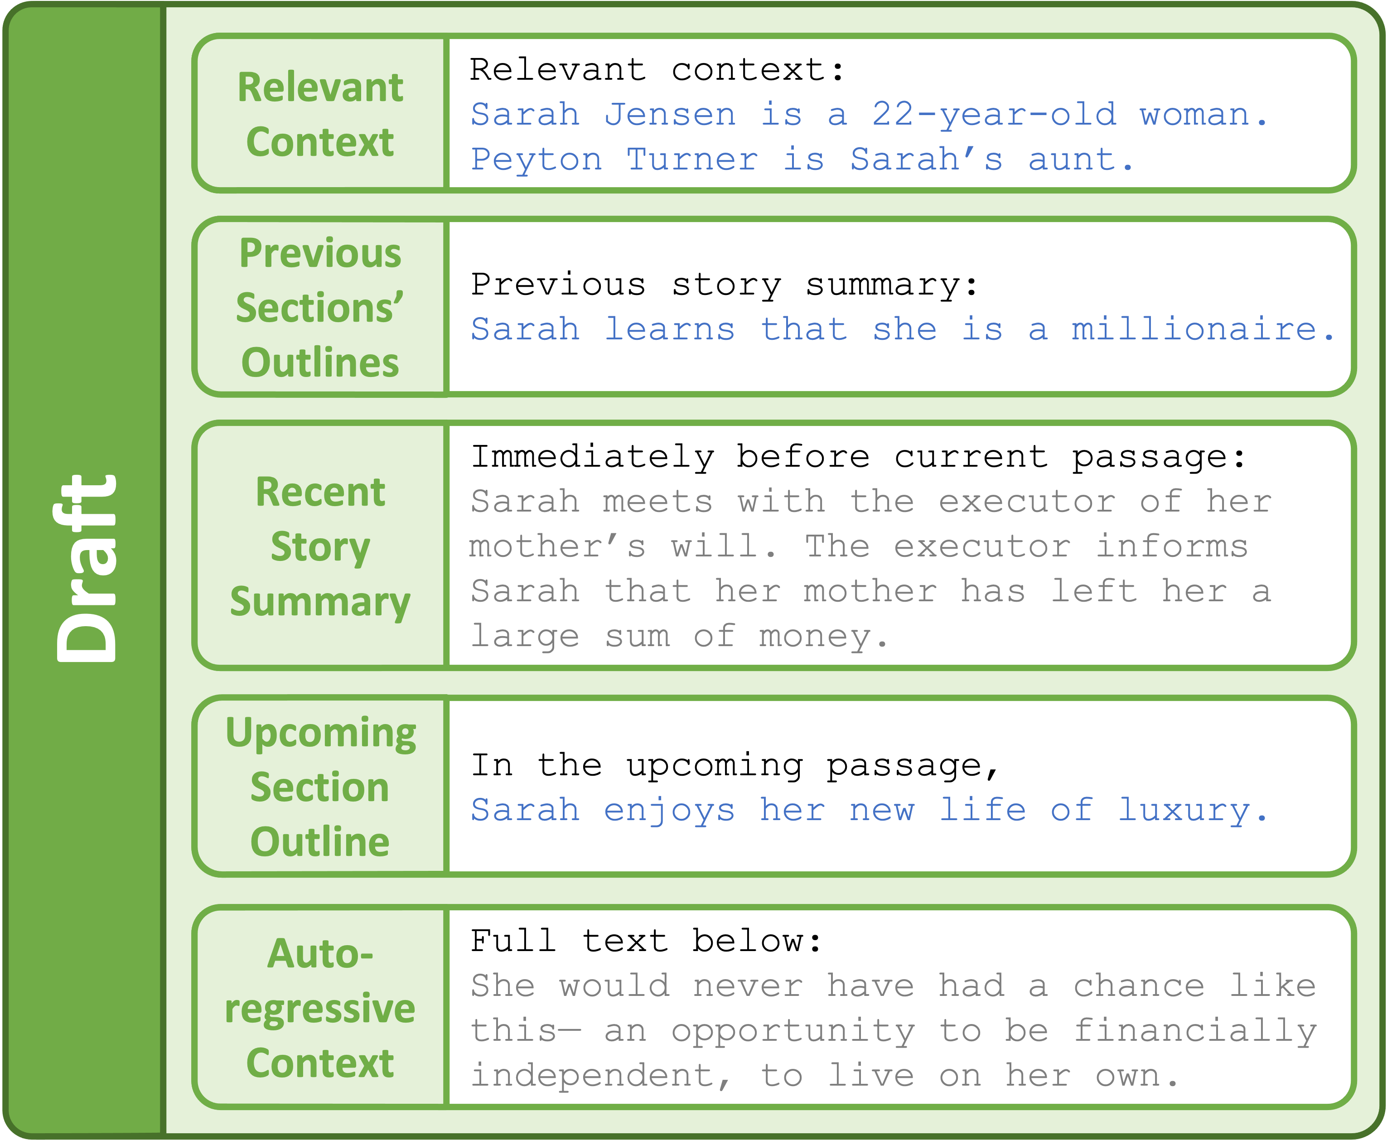
Draft Module
Story Continuations
Story Continuations
Story Continuations
LLM
Story Continuations

Slide 79
Draft Module
Story Continuations
Story Continuations
Story Continuations
LLM
Story Continuations

Slide 80
Draft Module
Story Continuations
Story Continuations
Story Continuations
LLM
Story Continuations

Slide 81
Draft Module
Story Continuations
Story Continuations
Story Continuations
LLM
Story Continuations

Slide 82
Draft Module
Story Continuations
Story Continuations
Story Continuations
LLM
Story Continuations

Slide 83
Draft Module
Story Continuations
Story Continuations
Story Continuations
LLM
Story Continuations

Slide 84
Rewrite Module
Premise
After years of being content with only a small inheritance, Sarah's life is turned upside down when she discovers she is actually a millionaire. She must learn to navigate her new life of luxury while also dealing with the guilt she feels over her new-found fortune.
Plan
LLM
Setting Characters Outline
Draft
Story Continuations
Story Continuations
Previous Story (if any)
Prompt
(Structured Context)
Story Continuations
LLM
Story Continuations
Rewrite
Best Story Continuation
Rerankers
Edit
LLM
Contradicted Facts
LLM
Final Edited Continuation

Slide 85
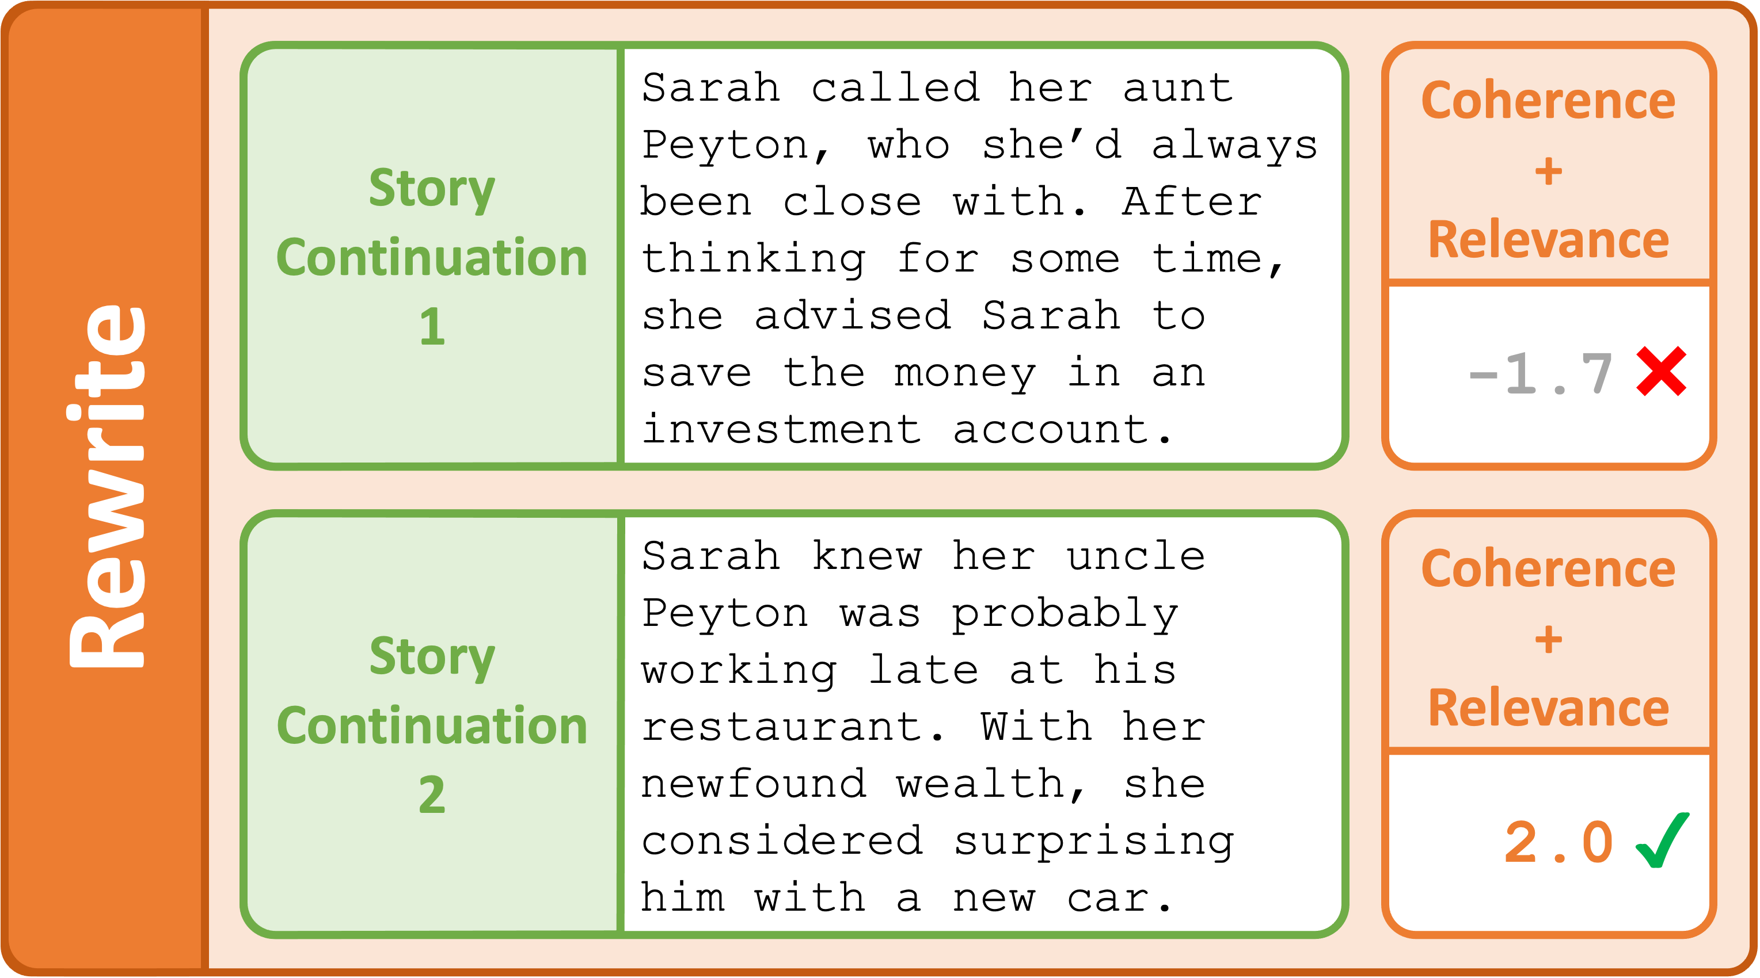
Rewrite Module

Slide 86
Rewrite Module

Slide 87
Rewrite Module

Slide 88
Rewrite Module

Slide 89
Rewrite Module

Slide 90
Rewrite Module
Nothing else in Re³ uses story datasets!

Slide 91
Ablation: No Rewrite Module

Slide 92
Ablation: No Rewrite Module
100
Re³ (No Rewrite)
Re³
67.3
63.3
59.7
56.7
56.0
46.3
42.3
42.7
0
% Interesting
% Coherent
% Relevant
% Humanlike

Slide 93
Edit Module
Premise
After years of being content with only a small inheritance, Sarah's life is turned upside down when she discovers she is actually a millionaire. She must learn to navigate her new life of luxury while also dealing with the guilt she feels over her new-found fortune.
Plan
LLM
Setting Characters Outline
Draft
Story Continuations
Story Continuations
Previous Story (if any)
Prompt
(Structured Context)
Story Continuations
LLM
Story Continuations
Rewrite
Best Story Continuation
Rerankers
Edit
LLM
Contradicted Facts
LLM
Final Edited Continuation

Slide 94
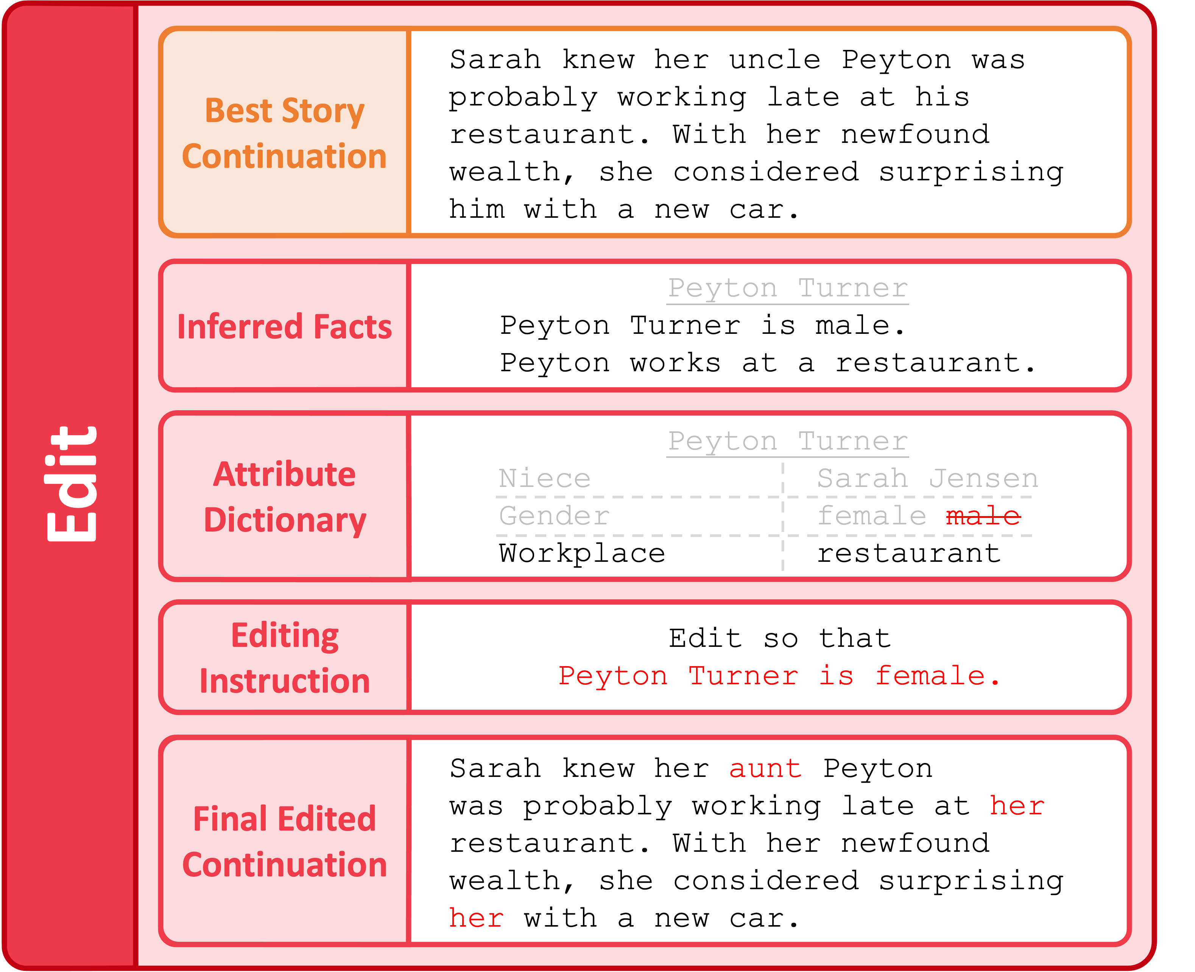
Edit Module

Slide 95
Edit Module

Slide 96
Edit Module
LLM

Slide 97
Edit Module
LLM

Slide 98
Edit Module
LLM
LLM

Slide 99
Edit Module
LLM
LLM

Slide 100
Edit Module
LLM
LLM
LLM

Slide 101
Ablation: No Edit Module

Slide 102
Ablation: No Edit Module
100
Re³ (No Edit)
Re³
87.7
87.0
60.3
59.3
59.3
55.0
57.0
57.3
0
% Interesting
% Coherent
% Relevant
% Humanlike

Slide 103
Takeaways
Challenging new task: long-form story generation
Long-range coherence, premise relevance, factual consistency
Recursive Reprompting and Revision framework
Simulate the human writing process
Inject the most relevant context into LLMs via structured prompting

Slide 104
Takeaways
Challenging new task: long-form story generation
Long-range coherence, premise relevance, factual consistency
Recursive Reprompting and Revision framework
Simulate the human writing process
Inject the most relevant context into LLMs via structured prompting

Slide 105
Takeaways
Challenging new task: long-form story generation
Long-range coherence, premise relevance, factual consistency
Recursive Reprompting and Revision framework
Simulate the human writing process
Inject the most relevant context into LLMs via structured prompting

Slide 106
Takeaways
Challenging new task: long-form story generation
Long-range coherence, premise relevance, factual consistency
Recursive Reprompting and Revision framework
Simulate the human writing process
Inject the most relevant context into LLMs via structured prompting

Slide 107
Takeaways
Challenging new task: long-form story generation
Long-range coherence, premise relevance, factual consistency
Recursive Reprompting and Revision framework
Simulate the human writing process
Inject the most relevant context into LLMs via structured prompting

Slide 108
Takeaways
Challenging new task: long-form story generation
Long-range coherence, premise relevance, factual consistency
Recursive Reprompting and Revision framework
Simulate the human writing process
Inject the most relevant context into LLMs via structured prompting

Slide 109



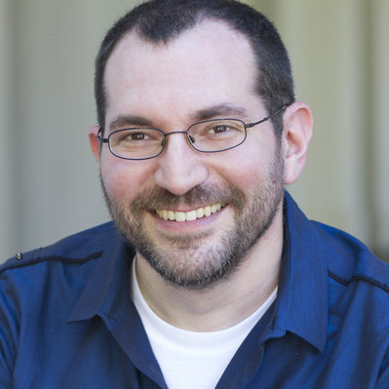
Thank you!
Paper: https://arxiv.org/abs/2210.06774
Code: https://github.com/yangkevin2/emnlp22-re3-story-generation

